Slide 1
UNDERSTANDING OCEAN CHEMISTRY AND BIOLOGY USING REAL-TIME DATA FROM PROFILING FLOATS
Kenneth Johnson, George Matsumoto
Monterey Bay Aquarium Research Institute
Carolyn Scheurle, Herve Claustre
Laboratoire d'Océanographie de Villefranche
Mary Jane Perry, University of Maine,
Stephen Riser, University of Washington

Slide 2



Feb. 16, 2012
Can real-time oceanographic data be used to increase the effectiveness of science education?

Slide 3
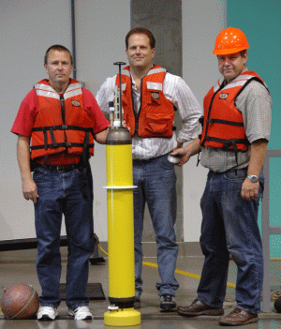
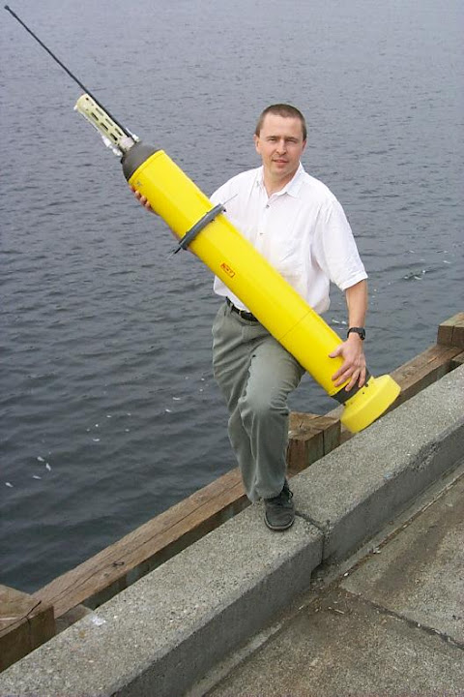
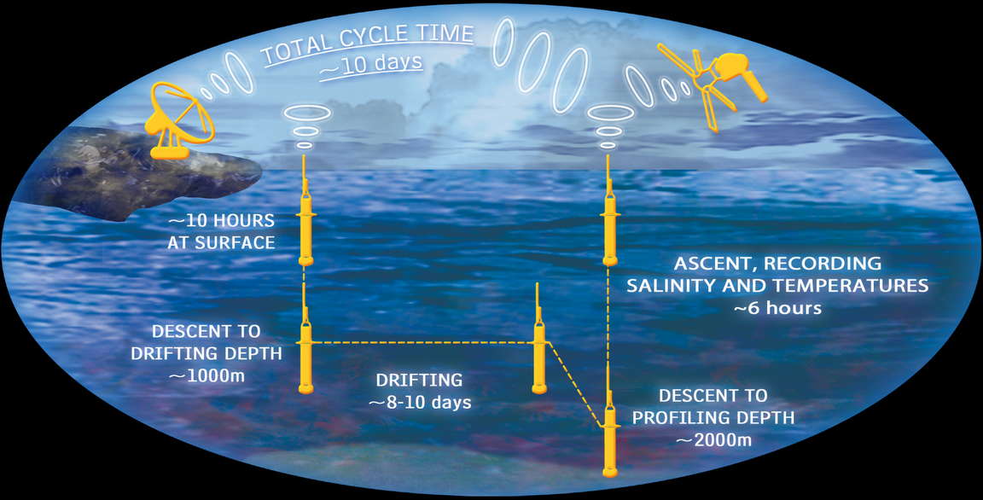
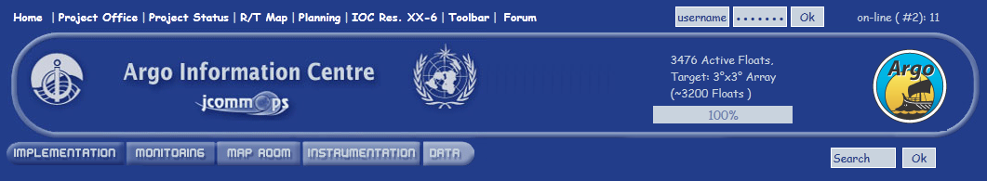
Profiling floats have a 4 to 5 year lifetime, make measurements from 1000 or 2000 m to the surface each 5 to 10 days. Data direct to Internet.
15 min.
5 to 10 days

Slide 4
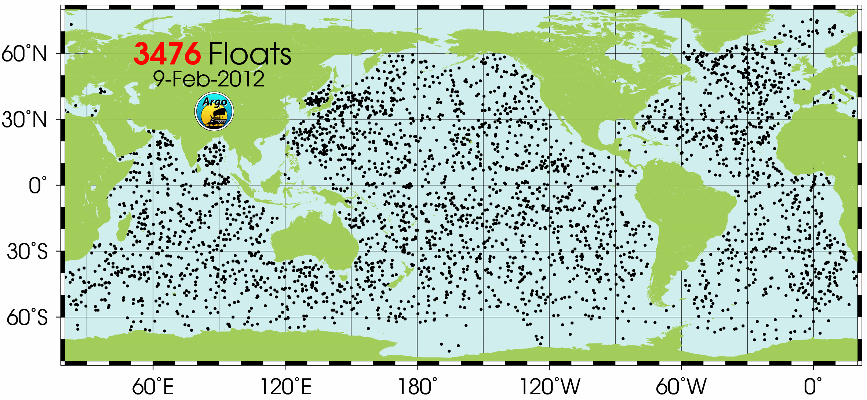
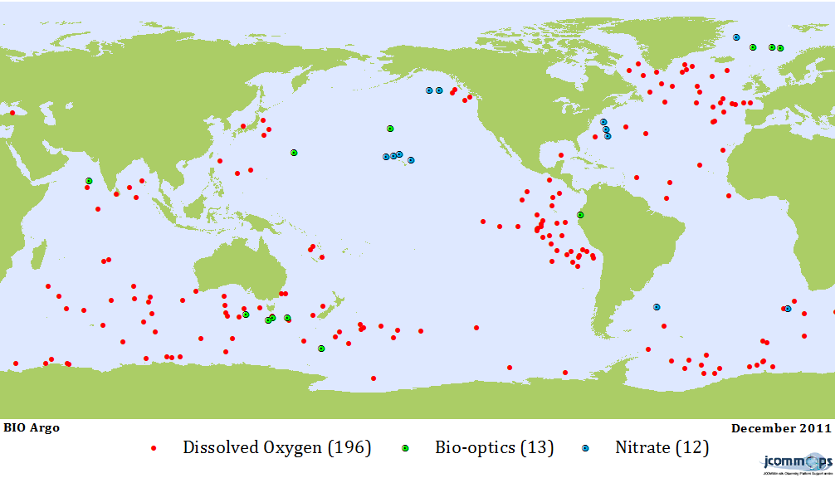
Thousands of floats.
Hundreds have biogeochemical sensors.

Slide 5
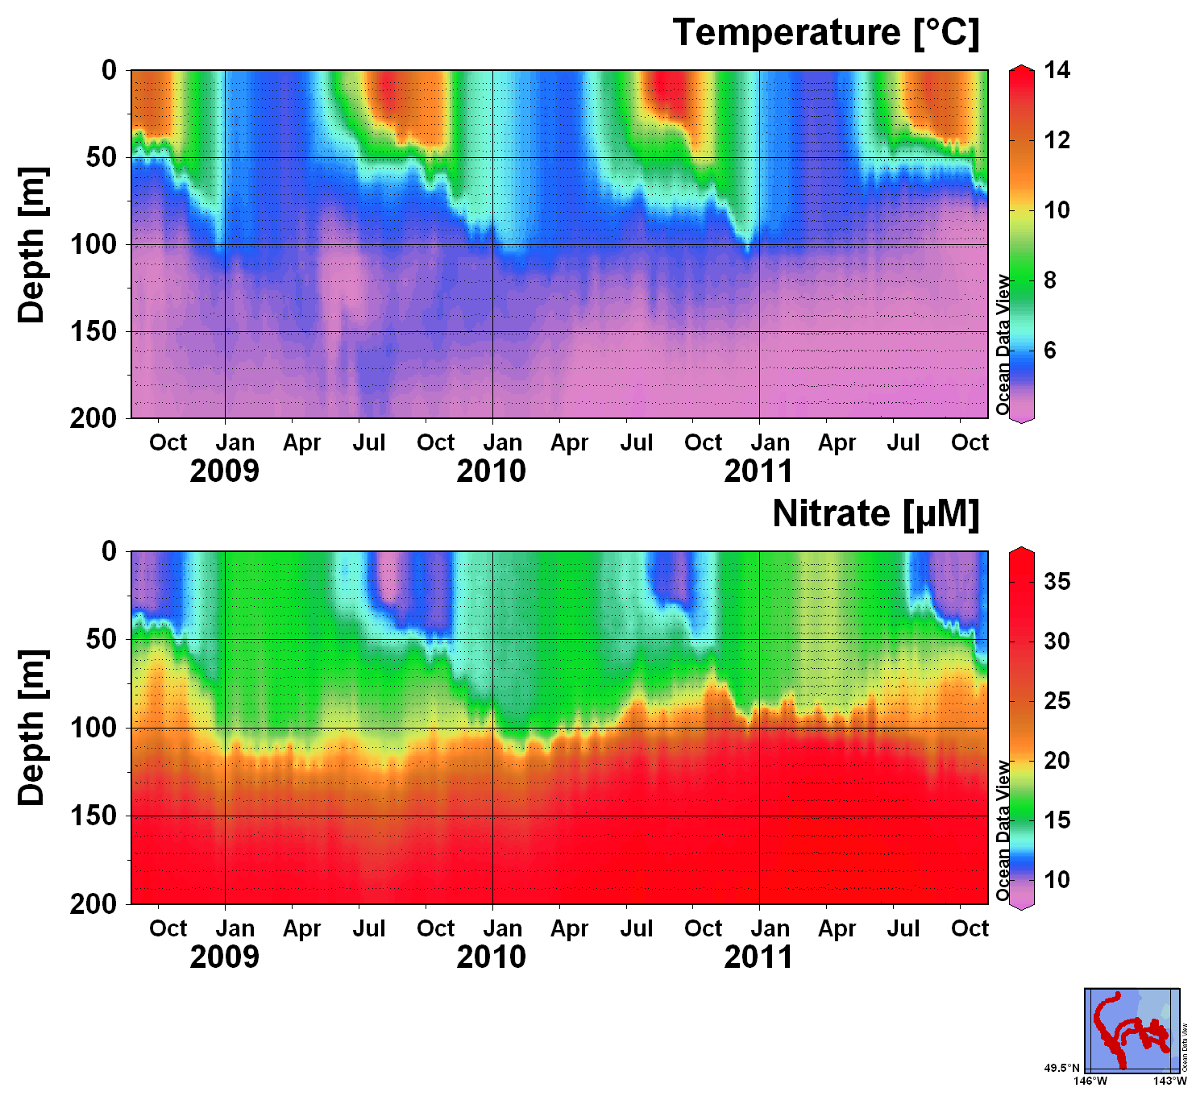
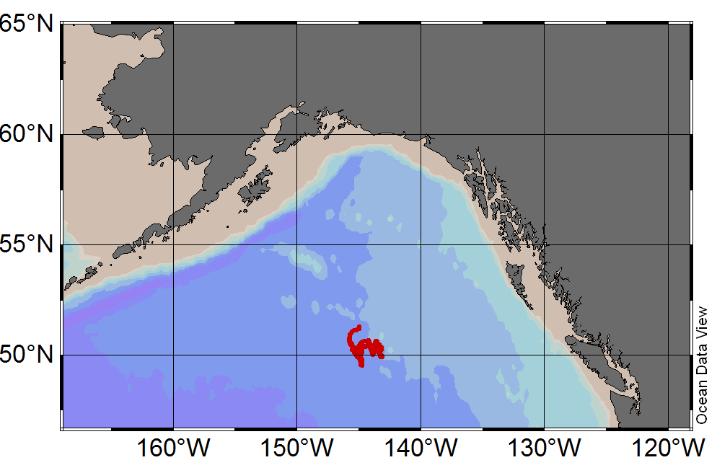
Biogeochemical sensors making beautiful records of ocean chemistry, biology & physics. How do we best create broader impacts?
Float 5145 and 6972 at Ocean Station Papa

Slide 6
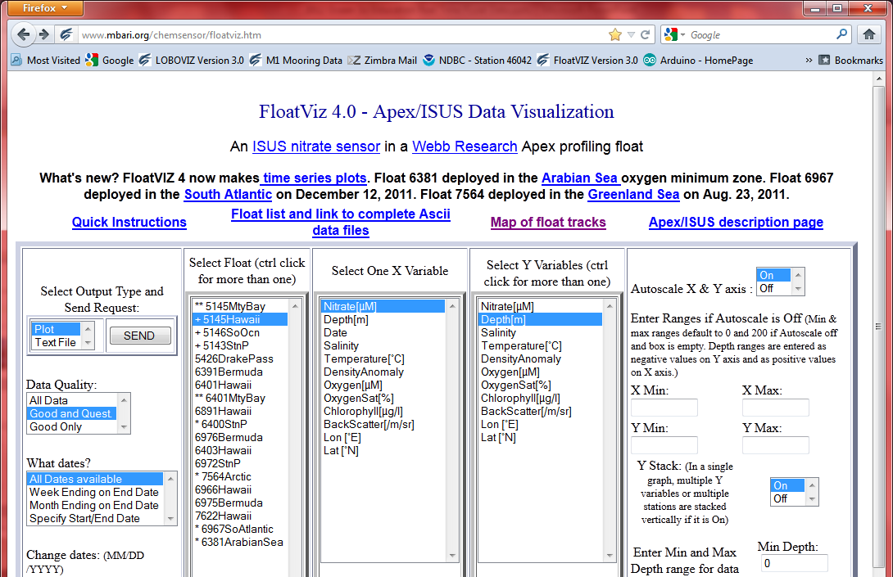
Make data easily accessible to students:
www.mbari.org/chemsensor/floatviz.htm developed with NSF support (OCE 0825348)

Slide 7
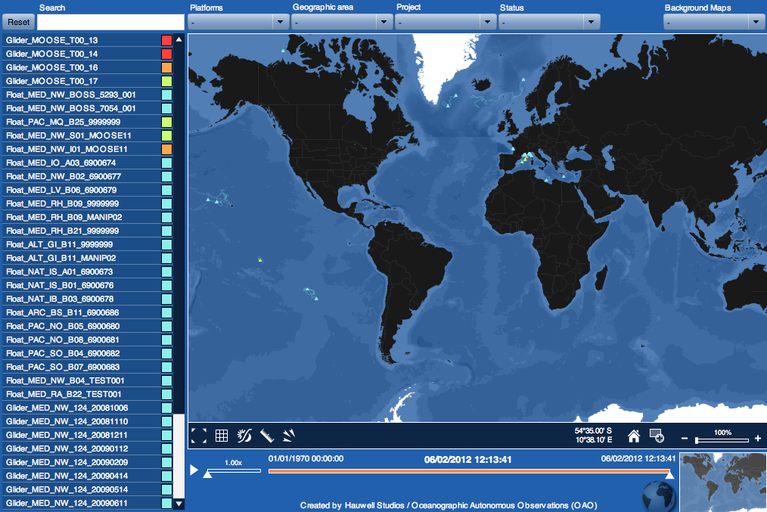
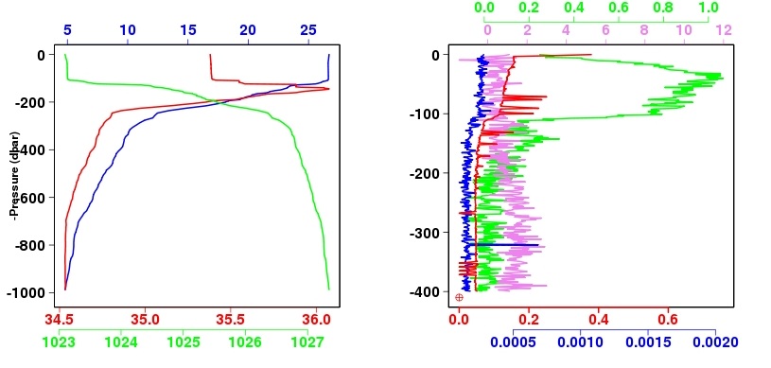
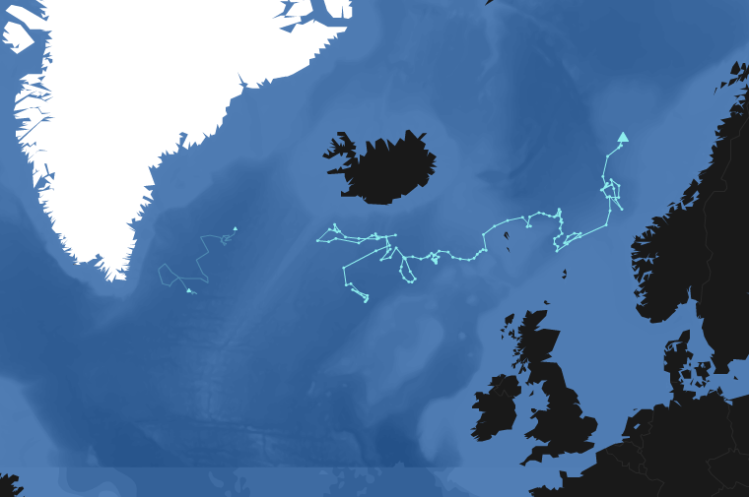
Oceanographic Autonomous Observations: web interface
All instruments (profiling floats & gliders) operated by OAO can be followed and their data viewed in real-time via the website: www.oao.obs-vlfr.fr
Notes:
OAO, Oceanographic Autonomous Observations, is a group of scientists and scientific engineers that is based at the marine observatory in Villefranche sur mer, France. Focusing on biogeochemical issues and with respect to the group’s recent evolutions, OAO developed a web interface in form of an interactive map. This map allows to display the actual locations of the instruments operated by OAO and close cooperators. Moreover, with few clicks, it allows to access and view the data collected in near real-time. Features, such as the different background maps and the weather forecast, help to better manage the profiling floats and gliders equipped with specific sensor configurations as well as to interpret the acquired data.
At the moment, this map is primarily used for scientific purposes. However, step by step, it will also be used as a tool to outreach. Modified in some aspects, e.g. the way to display the data in the graphs, and with some information added (e.g. graphics, pictures) the map shall meet the specific needs of a larger public and in particular of school environments. The work on a prototype of this outreaching map is underway and is conducted within the context of a one-year project together with a team of teachers of various disciplines.

Slide 8
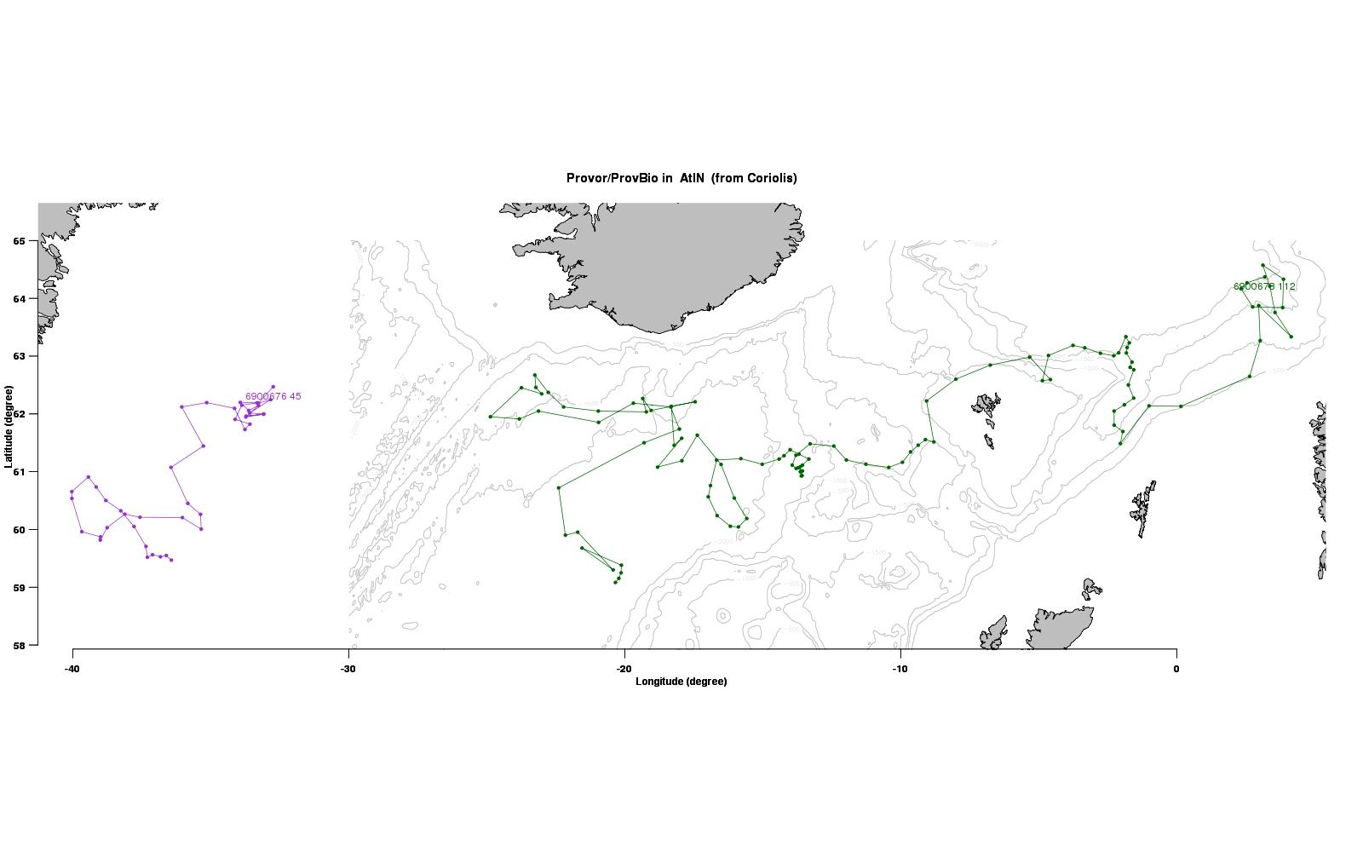
2. Use the float data as a window to the ocean to explore concepts developed in labs and lectures:
Oceanographic Autonomous Observations:
concept « adopt a float »
Originally initialized by SEREAD (Scientific Educational Resources and Experience Associated with the Deployment of Argo profiling floats in the South Pacific Ocean), now enlarged to biogeochemistry:
School classes may follow a profiling float during its scientific journey
Possibility to analyze data with teachers (educational resources provided by the scientists)
The interactive map shall be adapted to fit to these specific needs
  dedicated pages for the classes to participate and contribute (e.g. newsletters, films)
« Cross-adoption » may facilitate intercultural exchanges
Iceland

Irmincer Sea
Notes:
As part of this “school project”, it is envisaged to integrate the concept “adopt a float” – in the classroom but with an online access - via an internet portal and the interactive map - to 1) pedagogic material (mainly for the teachers and scientific facilitators) and 2) a participatory entry mainly reserved for pupils/school classes. The idea is to allow them to follow “their” profiling float on its scientific journey and so to facilitate a comprehension of certain oceanic issues and fundamentals. Testing of this concept in a pilot class should be possible by the end of the year.

Slide 9
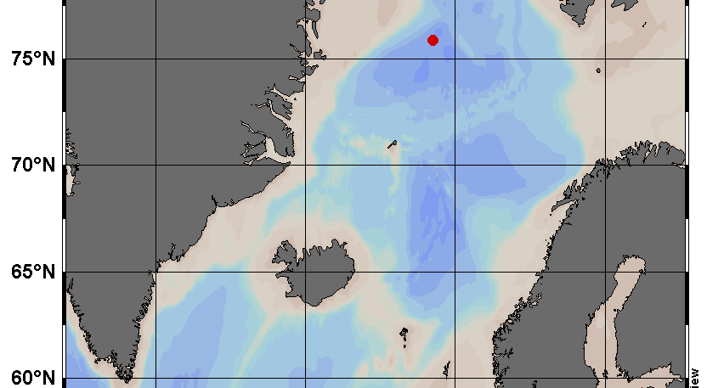
University of Maine, SMS 204, Integrative Marine Science II: Physics and Chemistry of Marine Systems (E. Boss, MJ Perry)
7564 Arctic float in Greenland Sea
Notes:
Mary Jane Perry’s class has adopted float 7564

Slide 10
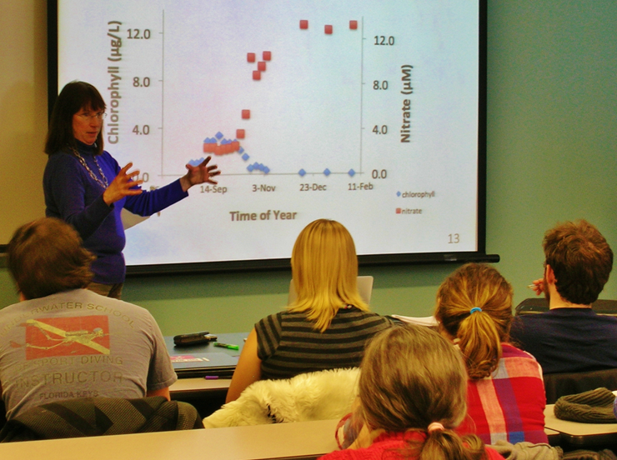
Students do laboratory experiments to understand phytoplankton growth and nutrient requirements.

Slide 11
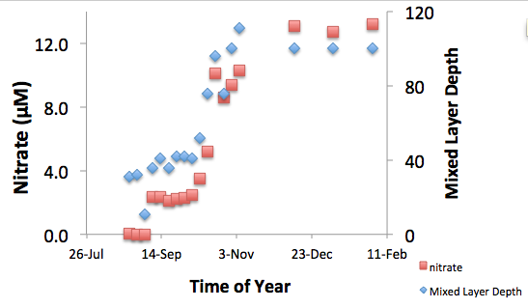
The 7564 float data in August and September reinforce the laboratory experiments. The storm increases nitrate concentration in the euphotic zone.

Slide 12
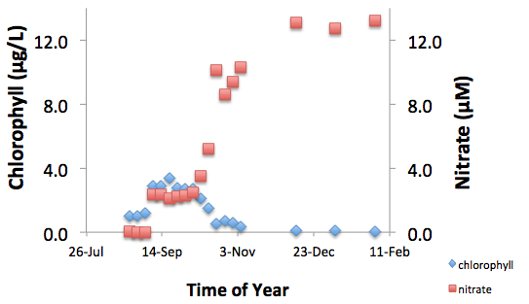
and the “classic” fall bloom results.

Slide 13
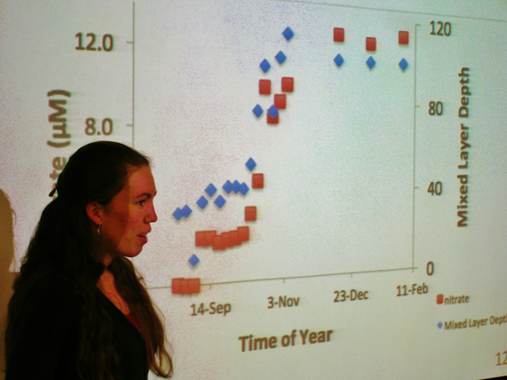
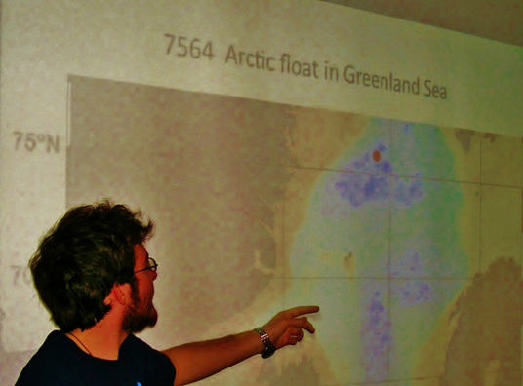
I had students stand up and explain the various graphs. They are all primed to find out when the spring bloom happens.

Slide 14
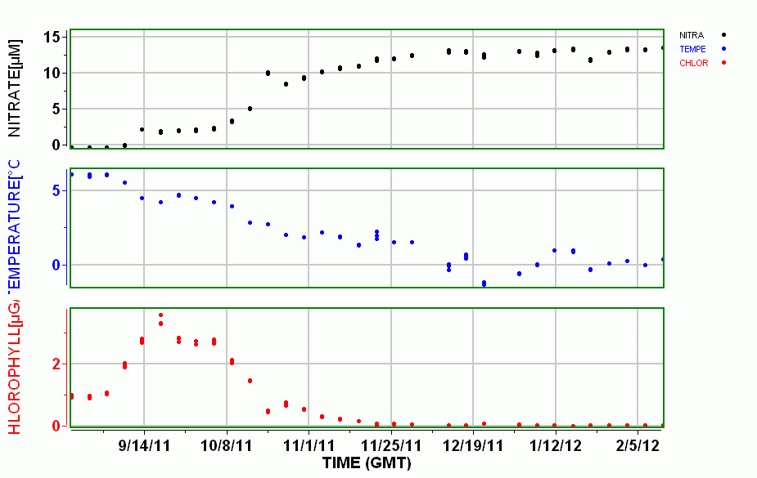
The fall phytoplankton bloom in the Greenland Sea – Float 7564Arctic
Zero nitrate,
No fertilizer
TEMPERATURE[°C]
Low chlorophyll =
Few phytoplankton
CHLOROPHYLL[µG/L]
Notes:
The would just reinforce point of previous slides – data is readily accessible with a few clicks and students can follow change in the ocean. FloatViz view of 7564

Slide 15
The fall phytoplankton bloom in the Greenland Sea – Float 7564Arctic
Nitrate injected
Storm mixes water column, bringing up cold, NO₃⁻ rich water
TEMPERATURE[°C]
CHLOROPHYLL[µG/L]
Phytoplankton bloom forms
Notes:
The would just reinforce point of previous slides – data is readily accessible with a few clicks and students can follow change in the ocean. FloatViz view of 7564

Slide 16
The fall phytoplankton bloom in the Greenland Sea – Float 7564Arctic
Vigorous mixing cools water, injects more nitrate, dilutes chlorophyll faster than plankton can grow
TEMPERATURE[°C]
CHLOROPHYLL[µG/L]
Notes:
The would just reinforce point of previous slides – data is readily accessible with a few clicks and students can follow change in the ocean. FloatViz view of 7564

Slide 17
The fall phytoplankton bloom in the Greenland Sea – Float 7564Arctic
When does water start to warm?
When does chlorophyll start increasing?
When will nitrate start decreasing?
Will we see deep convection?
I check weekly!!! I’m hooked.
Vigorous mixing cools water, injects more nitrate, dilutes chlorophyll faster than plankton can grow
TEMPERATURE[°C]
CHLOROPHYLL[µG/L]
Notes:
The would just reinforce point of previous slides – data is readily accessible with a few clicks and students can follow change in the ocean. FloatViz view of 7564

Slide 18
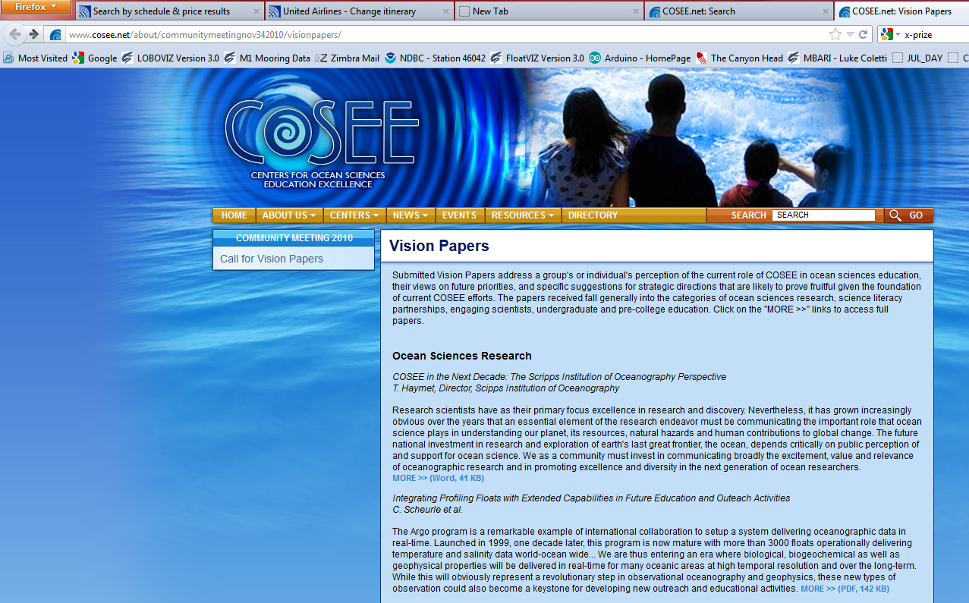
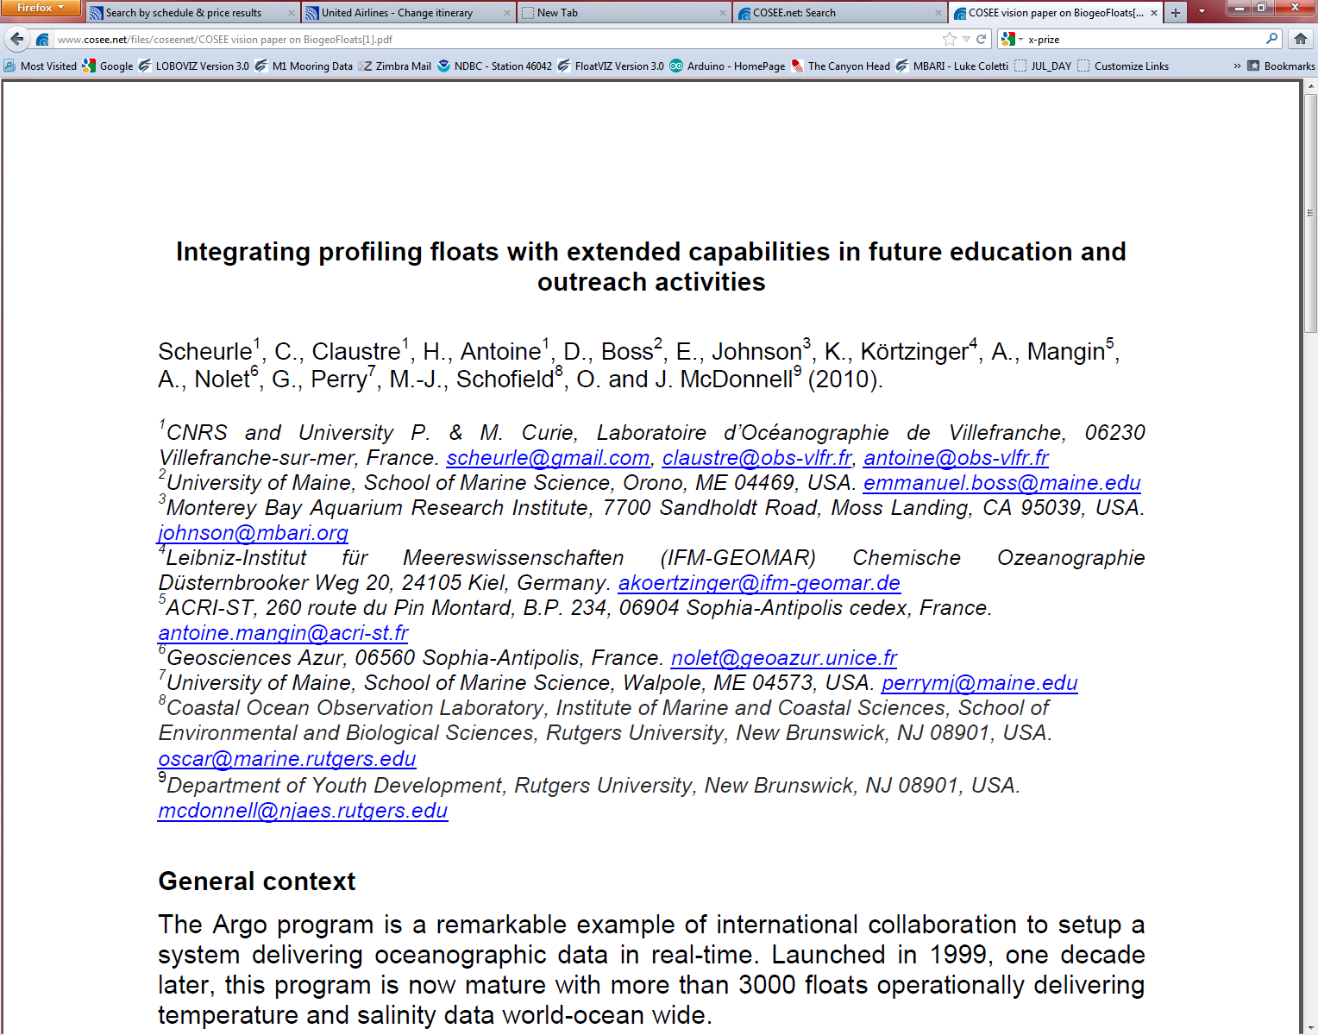
Notes:
Ending slide

Slide 19
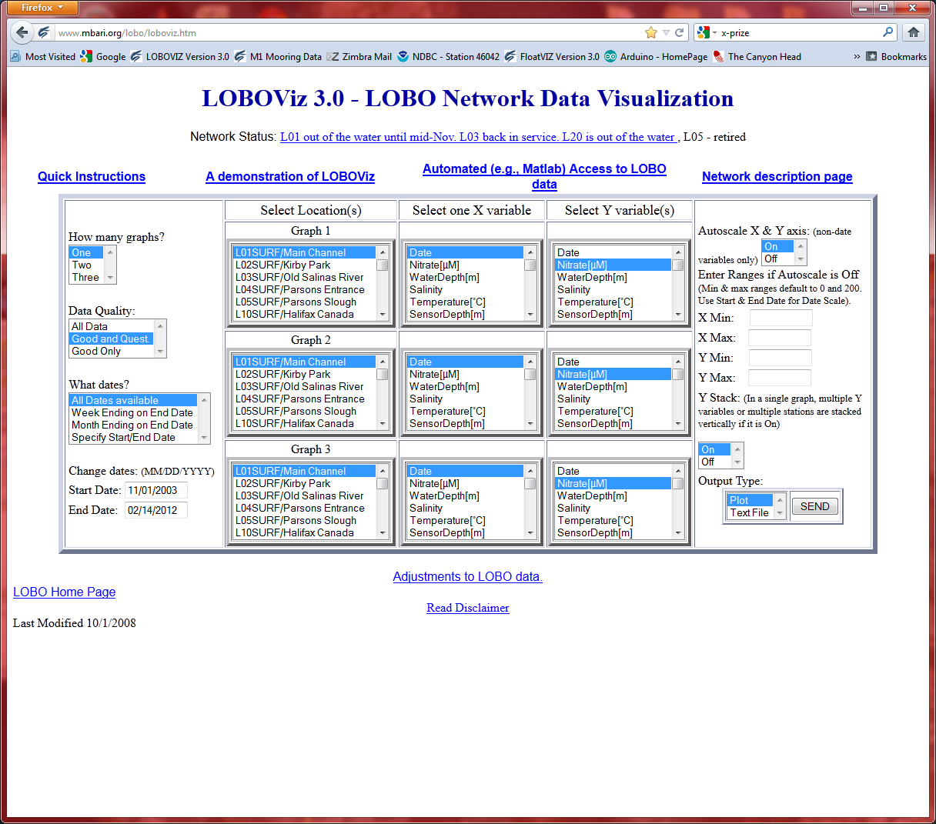
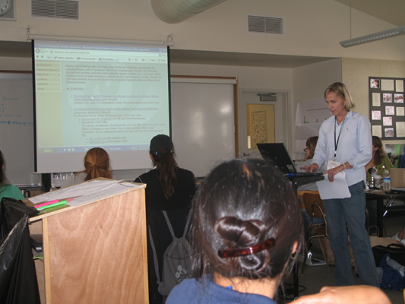
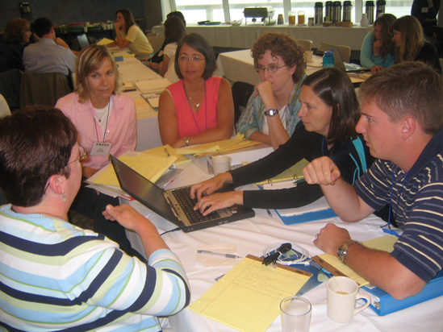
Notes:
Nice to work this in somewhere – LOBO used in teacher training workshops.

